Slide 1
Understanding the E-Portfolio
For SAASC, SJSU iSchool
October 27, 2015
By Beaudry Allen

Slide 2
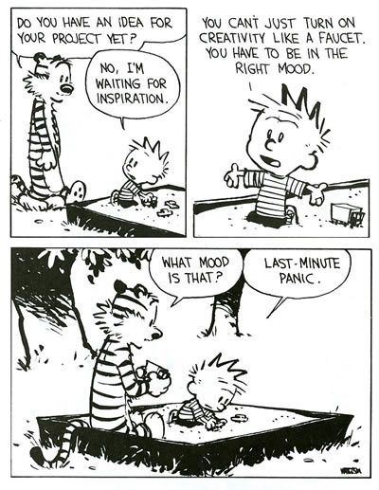
Introduction: Things to be Covered
Ways to approach the initial steps
What to expect
My experience and approaches to answering competencies
Time management

Slide 3
First Step: Don’t Panic
Make sure you have the most update
E-Portfolio guidelines
Before diving into answering each competency:
Gather all your material
Familiarize yourself with what you have
Don’t stress!
Assignments
Class Readings
Blog Posts
Conference Materials
Professional projects
Internship projects
Discussion Posts
Presentations

Slide 4
Second Step: What to Expect
Read the Guidelines and Competencies
Know word count requirements, questions (each question must be answered), due dates, etc.
Get to know your advisor’s expectations
Choose your E-portfolio format
Content over Style

Slide 5
My Portfolio

Slide 6
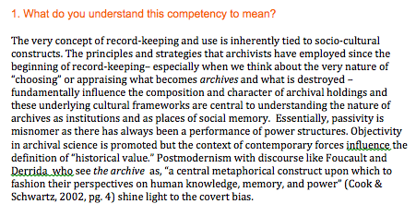
Third Step: Organizing Material
Organize your “evidence” to each competency
Expect to use 2-3 examples per competency
Pieces of evidence can overlap with a couple competencies
Don’t worry about it 100% fitting. You just need to prove how it relates
Incorporate readings
Spreadsheet: Competencies & evidence options
Free write: Have a notes page

Slide 7
Fourth Step: Execution My Layout

Slide 8
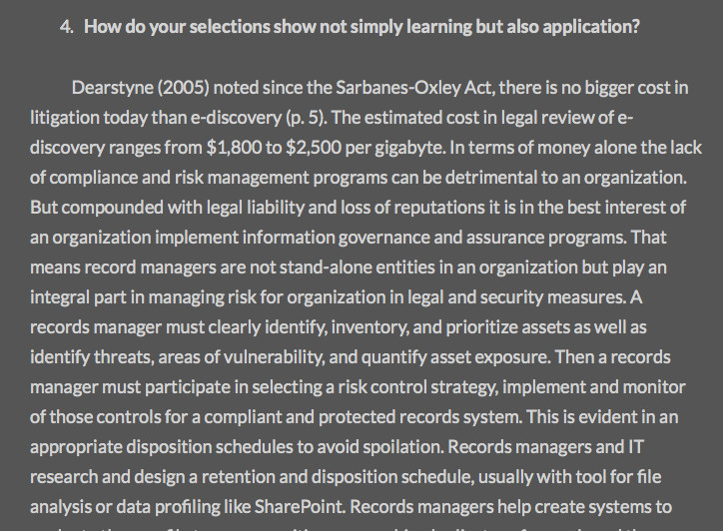
My Layout

Slide 9
Things to Think About
Tying in themes throughout
Use quotes AND citations
Incorporate your knowledge of standards, theories, trends
Add personal experience(s)

Slide 10
Its all About Time Management
Organize and work based on how well you know your work ethic & time constraints
Block out a weekly timeslot that is devoted solely to e-portfolio
Consider each competency as a mini analytical paper
Communicate !!
Talk to advisor(s), former students, and/or classmates- commiserate!

Slide 11
Questions ??
beaudryrallen@gmail.com

