Slide 1
Digital curation practices and professions
Alyce L. Scott
Lecturer, San Jose State University
SAA: SJSU Student Chapter, March 16, 2016

Slide 2
Professor Alyce Scott
Alyce Scott is a lecturer at the School of Information, San José State University. Ms. Scott has an M.L.I.S. from the University of Illinois at Urbana-Champaign. She has worked in a variety of library settings, including developing an electronic reserves program for Brookens Library at the University of Illinois Springfield. Most recently serving as the Coordinator of the Digital Imaging Program at the Illinois State Library (ISL). At the Illinois State Library Ms. Scott was part of the team that developed the Illinois Digital Archives; oversaw the digitization of materials from the ISL collection, including copyright compliance; reviewed and monitored Library Services and Technology Act digital imaging grants awarded annually by ISL; and provided state-wide training in the use of CONTENTdm software for digital collections.

Slide 3
Agenda
AGENDA:
Defining digital curation
Digital curation lifecycle
Digital curation skills/practices
Job opportunities in digital curation
Digital Curation Pathway
Agenda
Defining digital curation
Overview of INFO 284: "Tools, Services, and Methodologies for Digital Curation“
Job opportunities in digital curation

Slide 4
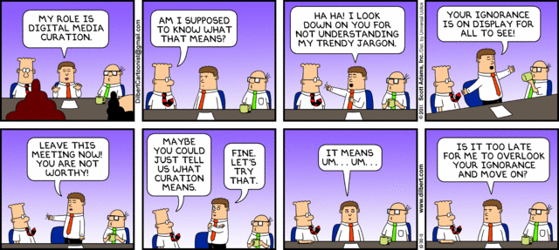
http://dilbert.com/strips/comic/2011-10-30/

Slide 5
Content curation
Content curation requires more than just the selection of information. It’s the assembling, categorizing, commenting and presenting the best content available.
Content curation is the gathering, organizing and online presentation of content related to a particular theme or topic.
In simple terms, the process of content curation is the act of sorting through large amounts of content on the web and presenting the best posts in a meaningful and organized way. The process can include sifting, sorting, arranging, and placing found content into specific themes, and then publishing that information.
Content curation is the process of gathering information relevant to a particular topic or area of interest. Services or people that implement content curation are called curators.

Slide 6
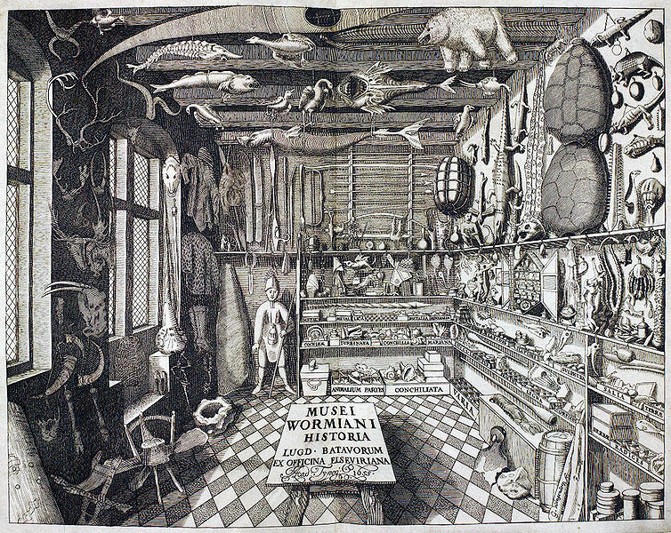
1655: cabinet of curiosities
http://en.wikipedia.org/wiki/File:Musei_Wormiani_Historia.jpg

Slide 7
Digital curation
Digital curation is larger than digital preservation; it includes preservation but also creation or selection, appraisal, ongoing maintenance and enhancement. Data curators are expected to facilitate the use and reuse of datasets by interacting with creators and users, maintaining documentation, and establishing linkages with other resources.
Priscilla Caplan

Slide 8
Digital curation
Digital curation involves maintaining, preserving and adding value to digital research data throughout its lifecycle.
The active management of research data reduces threats to their long-term research value and mitigates the risk of digital obsolescence. Meanwhile, curated data in trusted digital repositories may be shared among the wider …research community.
…curation enhances the long-term value of existing data by making it available for further…research.
Digital Curation Centre

Slide 9
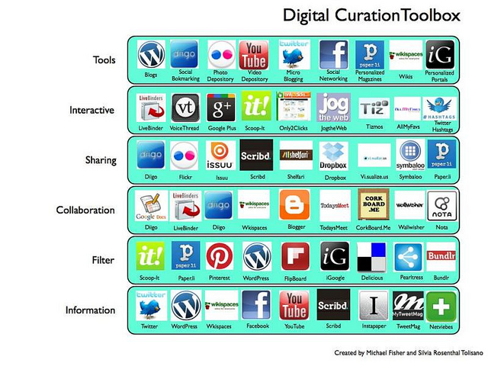
Recognize these tools?
http://www.benjanefitness.com/news-1/digitalcurationinhealthexerciseandeducation
Notes:
I

Slide 10
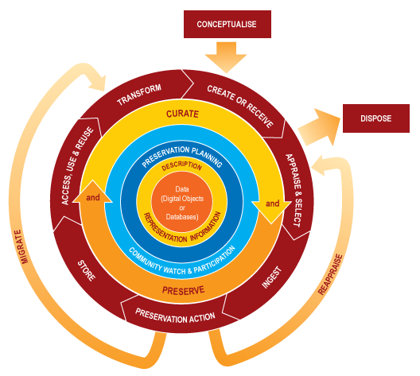
DCC Digital Curation Lifecycle Model
http://www.dcc.ac.uk/resources/curation-lifecycle-model

Slide 11
Lifecycle stages
Conceptualize
Create
Access and use
Appraise and select
Dispose
Ingest
Preservation action
Reappraise
Store Transform
http://www.standingdog.com/blog/the-life-cycle-of-a-website

Slide 12
Skills/competencies needed for digital curation
Interpersonal communication
Curating and preserving content
Curation technologies
Environmental scanning
Management, planning and evaluation
Services
Systems, models and modeling
Kim, J., Warga, E., & Moen, W.E. (2013). Competencies Required for Digital Curation: An Analysis of Job Advertisements. International Journal of Digital Curation, 8 (1), 78-79.

Slide 13
Job opportunities in digital curation
Senior Digital Scholarship Librarian
Federal Reserve Bank of Kansas City
This new position will manage a team of three library staff as part of the Center for the Advancement for Data and Research in Economics (CADRE). In addition to continuing to provide reference services, strategic collection development, and other information services, this team will spearhead new research support initiatives such as curation of research data, promotion of Bank research and analytical output, and educating the research staff on issues related to intellectual property and emerging measures and metrics for assessing the scholarly impact of publications and other forms of scholarly expression.

Slide 14
Job opportunities in digital curation
Librarian (Digital Curation)
Public Library, DC (Washington, DC)
Description: The Digital Curation Librarian is primarily responsible for managing digitization for the Library’s unique and historical materials and curating digital content.
Duties:
Provide expertise on workflows, tools, and best practices to manage born-digital content.
Strategize, develop, and communicate policies and processes for creating accessions, processing, ingesting, and describing born-digital materials.
Coordinate outsourced digitization projects with vendors; implement internal quality checks for deliverables.
Develop efficient workflow models for in-house digitization and scan-on-demand services.
Develop online exhibits and programming to promote the digital special collections.
Advise the Special Collections Manager on issues related to the Library’s digital assets management system (DAMS), the DAMS as it relates to the OPAC, and other discovery tools.

Slide 15
Job opportunities in digital curation
Director, University of California Curation Center (UC3)
Responsible for:
envisioning and articulating a dynamic and forward-thinking strategic vision for digital curation
digital preservation and research data management activities at the California Digital Library, University of California
provides oversight, encourages collaboration and innovation, and ensures the successful stewardship and sustainability of UC3's systems, services, and initiatives intended to respond to the scholarly research needs of the UC Libraries, faculty, students, and staff.
Requirement: Expertise in digital library, digital curation, research data management, and scholarly communication theory and practice.

Slide 16
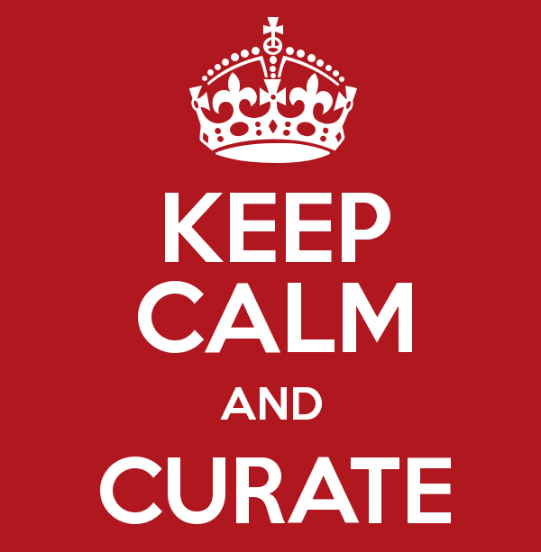
Digital curation titles
Data Curators
Data Curation Librarians
Data Services Specialist
Digital Archivists
Digital Assets Managers
Digital Curation Archivists
Digital Collections Managers
Digital Humanities Librarian
Digital Repository Analyst
Digital Preservation Specialist
Digital Preservation Managers
Humanities Curator
Image Resources Coordinator
Informatics/data Services Specialists
Metadata Librarians
Scientific Data Curator
Spatial Data Analyst/Curators
From: http://ischool.sjsu.edu/current-students/career-pathways/digital-curation
http://www.nebseo.com/seo/traffic-curation-done-correctly/

Slide 17
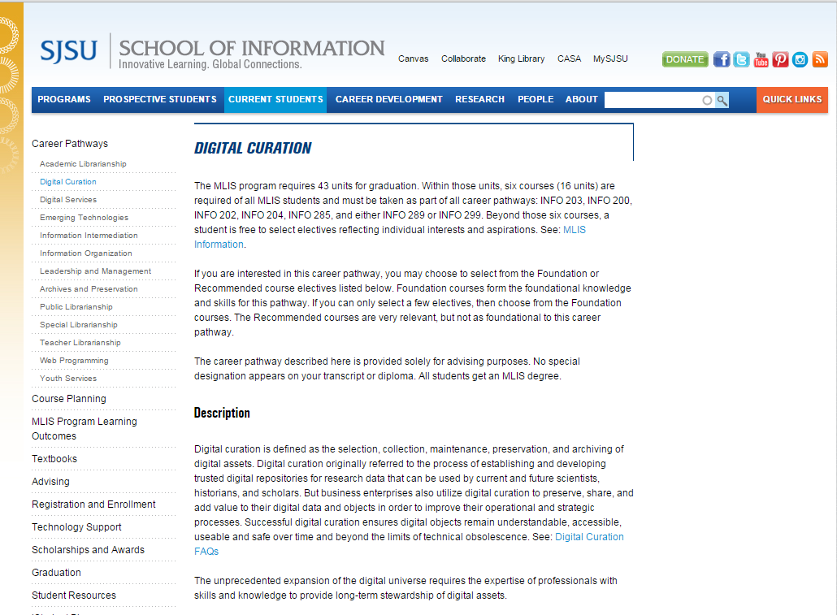
Digital Curation Pathway
http://ischool.sjsu.edu/current-students/career-pathways/digital-curation

Slide 18
Questions…
www.istockphoto.com

Slide 19
Stay Connected!
Contact Us!
Upcoming events!
Gmail: sjsusaasc@gmail.com
Delicious: https://delicious.com/sjsusaasc
Facebook: https://www.facebook.com/groups/29671378601/
Twitter: @sjsuslis_saasc
Website: http://sjsusaasc.weebly.com/
April 26 @ 6pm: Current trends in preservation management and career pathways
In the works!
In person tour of Huntington Library
Mini Conference at California State Archives

Slide 20
Thank you Professor Scott! And thanks to all who joined us!

